Slide 1

Analysis of Citywide Payroll Data
Team12: Ryan Austin Yon, Yunhan Zhang

Slide 2
Agenda
Data Exploration
Experimental Questions
Data Cleaning
Data Analysis
Conclusion
Closing Questions

Slide 3

This data was collected to serve the public interest in how major City’s budget is being distributed on salary and overtime pay for all municipal employees.
The dataset contains 4.5 million rows and 17 columns of data.
The dataset was collected from data.cityofnewyork.us.

Slide 4
Questions Asked
How the City’s budget is being spent on salary and overtime pay for all municipal employees?
How does salary look like before and after the COVID-19?
How does overtime hours look like before and after the COVID-19?
How does salary look like before and after the COVID-19 in each borough?

Slide 5
Data Dictionary
Fiscal Year: Fiscal Year (2014 to 2022);
Agency Name: The Payroll Agency that the employee works for (Fire Department, Board of Election);
Work Location Borough: Borough of employee’s primary work location (Brooklyn, Washington DC);
Title Description: Civil Service title description of the employee (dentist, school security manager);
Base Salary: Base Salary assigned to the employee;
OT hours: Overtime Hours worked by the employee in the fiscal year;
Total OT Paid: Total overtime pay paid to the employee in the fiscal year;

Slide 6
Data Cleaning
Imported and explored the information available in this dataset.
Created a data dictionary to further understand each column.
Consolidated missing values across the entire dataframe.
Replaced missing values in “Work Location Borough” and “Title Description”
“Unknown”
Transformed columns “Agency Name”, “Work Location Borough”, and “Title Description”
Type String
Lower case

Slide 7
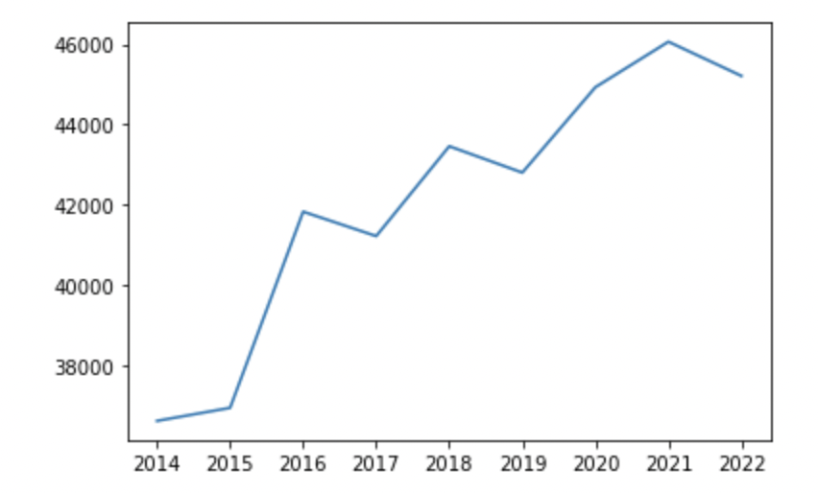
Change in average base salary (2014 - 2022)
Base salary for all NYC payroll was continuing to grow from 2014 - 2020.
Post-pandemic (2021 - 2022) these numbers have started to decrease significantly.

Slide 8
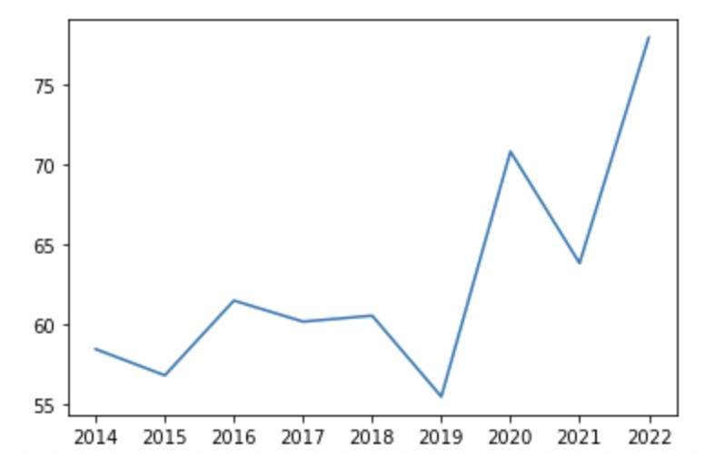
2. Changes in average overtime pay (2014 - 2022)
Total overtime was mildly stable for the period before the pandemic (2014 - 2018).
Once the pandemic hit there was a surge in overtime hours that has continued to climb (2019 - 2022).

Slide 9
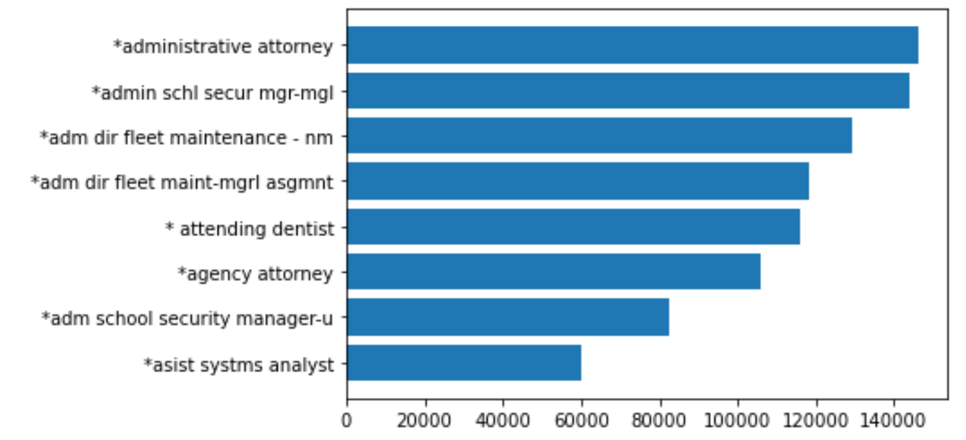
3. Job titles with the highest base salary pre-pandemic (2014 - 2018)
The top three jobs with the highest base salary pre-pandemic are Admin Attorney, School Security Manager, and Admin Fleet Management Director.

Slide 10
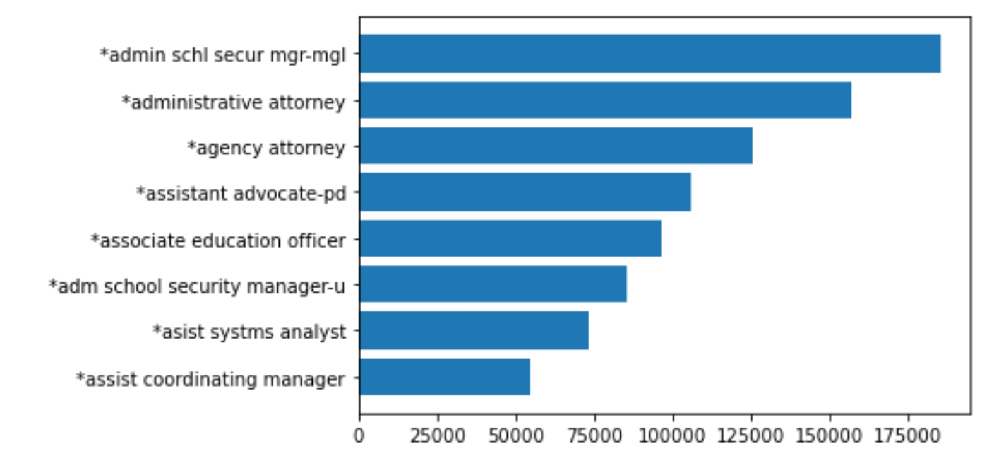
4. Job titles with the highest base salary post-pandemic (2019 - 2021)
The top three jobs with the highest base salary post-pandemic are School Security Manager, Admin Attorney, and Agency Attorney.

Slide 11
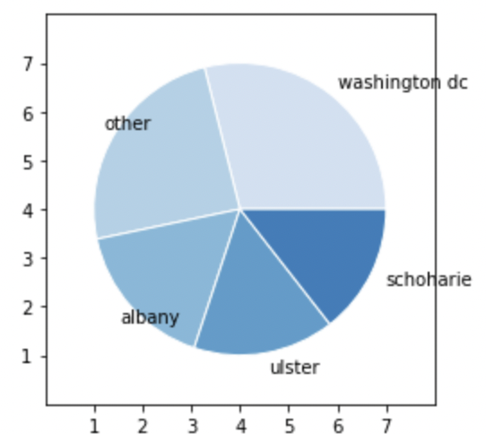
5. Base salary per pay borough (2014 - 2022)
The pie chart indicates the top paid boroughs on NYCs payroll.
Washington, DC is the highest paid borough.

Slide 12
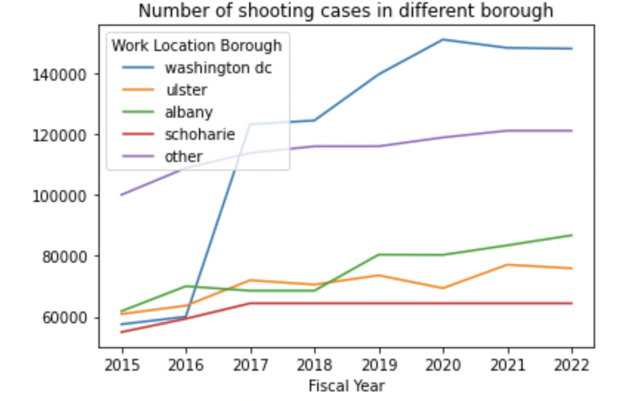
6. Change in base salary per borough (2015 - 2022)
The line chart indicates that Washington, DC also had a significant jump in pay since the year 2016.

Slide 13
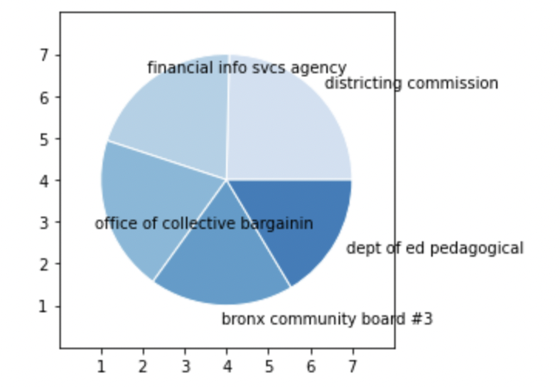
7. Median Base Salary per Agency (2014 - 2022)
The pie chart indicates the top 5 agencies with the highest paid base salary.
Districting Commission was the highest Agency with the others paying close to the same amount.

Slide 14
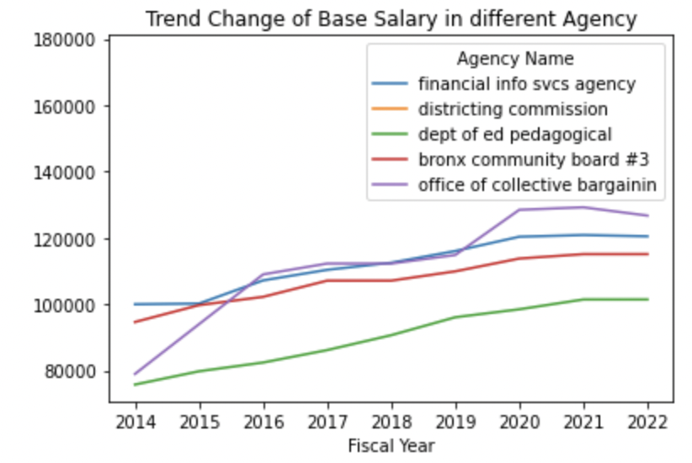
8. Change in base salary per agency (2014 - 2022)
The line chart indicates change in base salary for the 5 highest paid agencies from 2014 - 2022.
It can be seen that the pandemic had little effect on the salaries of these agencies.

Slide 15
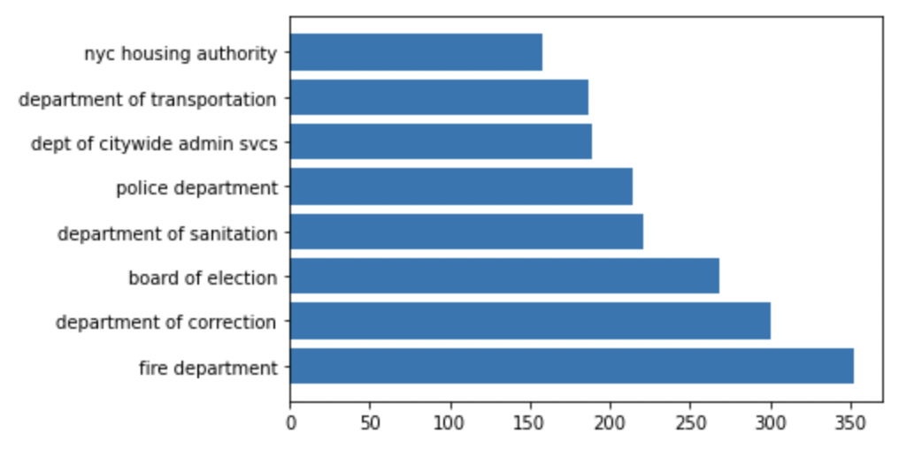
9. Average overtime per agency (2014 - 2022)
This bar chart displays the top 5 agencies with the highest average overtime from 2014 - 2022.
It can be seen that the fire department clocks the highest average of overtime out of all 5 agencies.

Slide 16
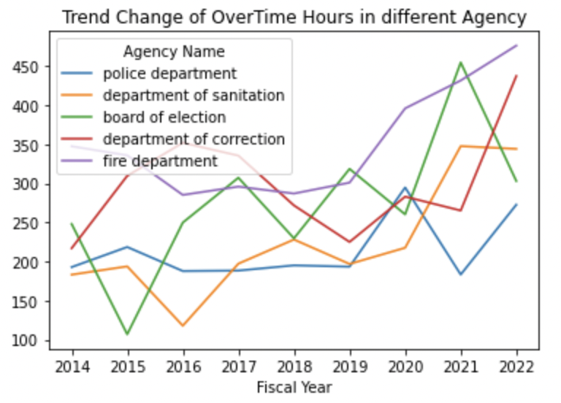
10. Change in overtime hours per agency (2014 - 2022)
The line chart displays the trend of average overtime for the 5 agencies from 2014 - 2022.
It is clear that there was a serge in overtime for all 5 agencies after the pandemic.

Slide 17
Conclusion
The average base salary was significantly higher just before the pandemic hit in 2019 than what they were in 2014. The median income had increased by $28,000 in 2014 to $43,000 in 2019 (53% increase). When entering the pandemic, the growth rate has slowed down by 16%. Post-pandemic these numbers have began to decrease and showing a slow but steady improvement.
Jobs like attorneys and school security managers were assigned with very high base salary among other job titles.
Washington DC is tend to be the best city to work at, since it has the highest base salary and its trend is still going up and much higher than other cities.
COVID -19 definitely affected overtime hours on some hard core agencies such as police departments caused by some safety issues around different cities during the quarantine.

Slide 18

Questions?

